Slide 1

LOS COLORES- THE COLOURS https://www.youtube.com/watch?v=lE9DhBqJ0T0

Slide 2


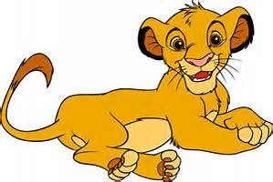

SOL
LEÓN
ESTRELLAS
AMARILLO-YELLOW

Slide 3

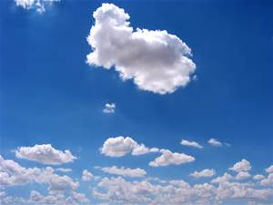
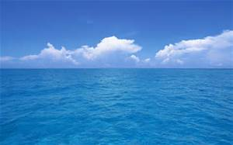
AZUL-BLUE
CIELO
MAR

Slide 4




ROJO-RED
CORAZÓN
MANZANA
TOMATE

Slide 5


VERDE-GREEN
MONTAÑAS

Slide 6


MORADO-PURPLE
UVAS

Slide 7
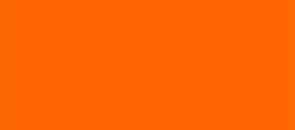
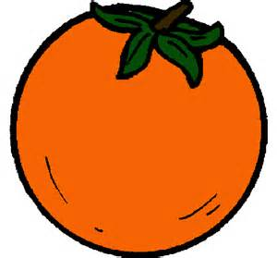
NARANJA-ORANGE
NARANJA

